Slide 1
Picture This II Democratizing Data with Google Data Studio
Presenter
Jamison Crawford, MPA
Institutional Researcher, Georgia State U.
Faculty Associate, Arizona State U.
Instructor, Georgia State U.
Facilitator
Dori Neptune, MA

Slide 2
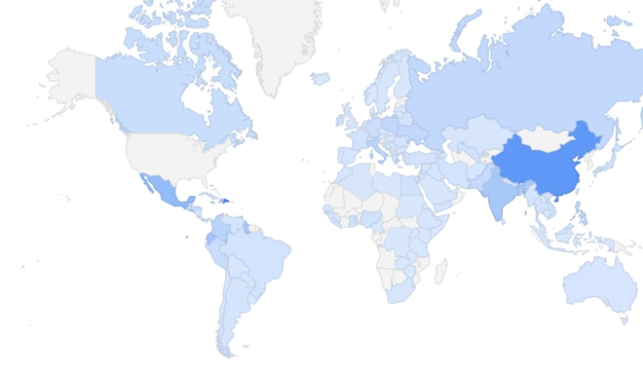
Contents
Introduction
Google’s Office Suite
What is Google Data Studio?
Data Studio Features & Integration
Demonstration
Questions
Image Source: Crawford (2020)

Slide 3
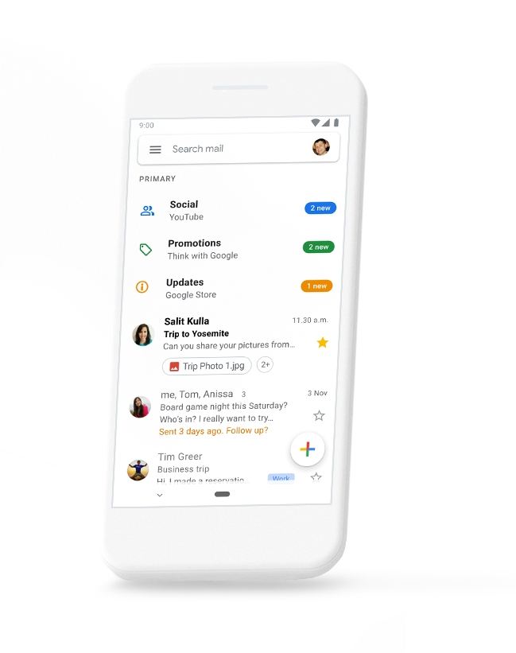
Google’s Office Suite
Cloud-based collaborative applications
Gmail, Docs, Sheets, Slides, Analytics
“Suites” = “Productivity Software”
Desktop use, mobile responsivity
Notably: Interfacing ecosystem
Image Source: Google Gmail
Notes:
Productivity Software: Application software used for producing information (documents, presentations, etc.)

Slide 4
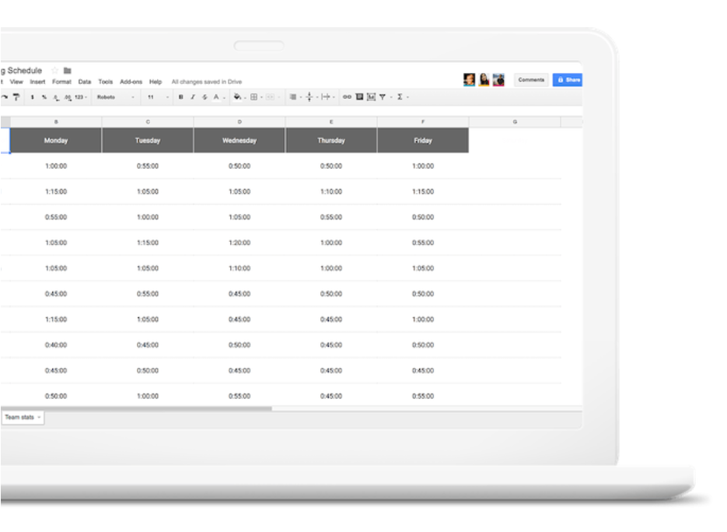
Google Sheets
Cloud-based spreadsheet software
Allows real time updates, collaboration
Fluid transition to, from MS Excel
More extensive functions than MS Excel
Data backend for interfacing apps
Image Source: Google Sheets

Slide 5
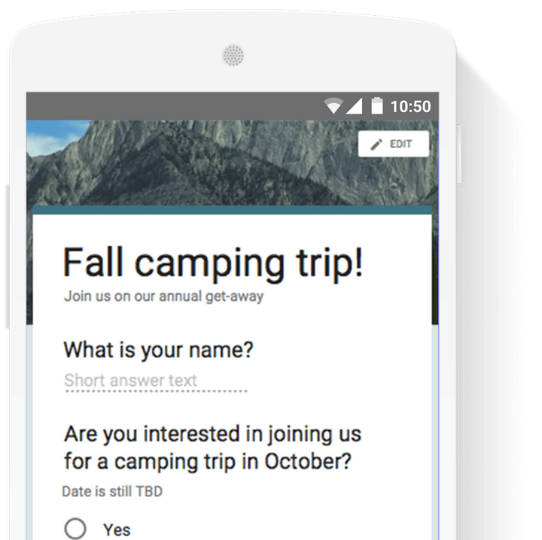
Google Forms
Cloud-based survey software
Allows real time editing, responses
Sharable, embeddable in web pages
Rich features, response summaries
Frontend input for Google Sheets
Image Source: Google Forms

Slide 6
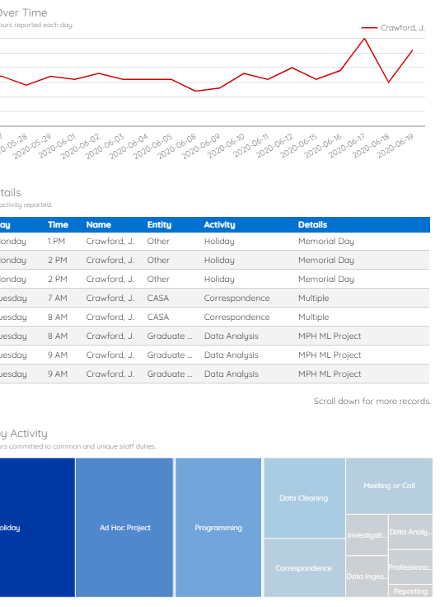
Google Data Studio
Cloud-based, real time dashboarding tool
Multiple data sources; transforms, filters
Easy-to-build, interactive visualizations
Excellent for reporting or exploring
Interfaces with Google Sheets, etc.
Image Source: CASA Performance Man. Dashboard (Crawford, 2020)

Slide 7


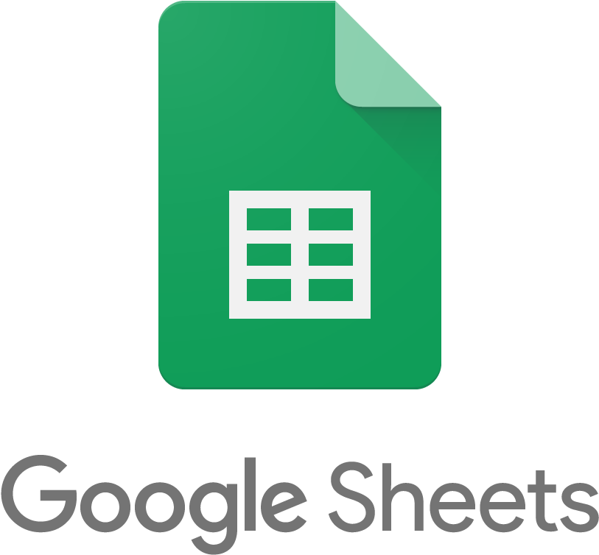
Big Picture: Interfacing Apps
Forms
Sheets
Data Studio
Image Source: Google

Slide 8
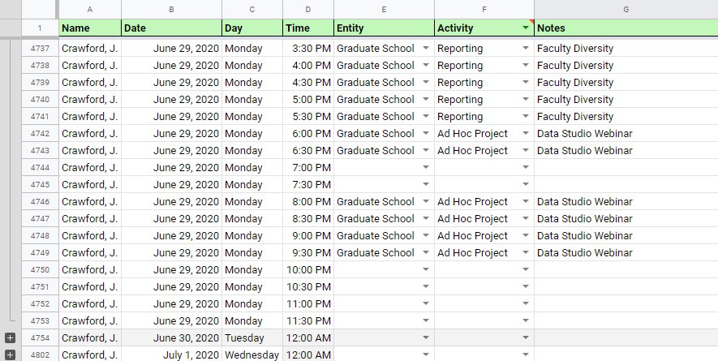
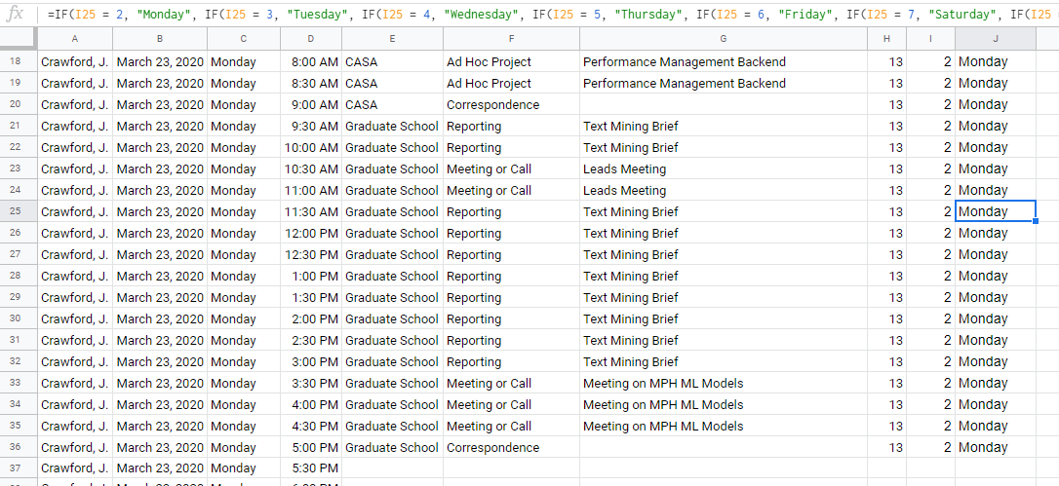
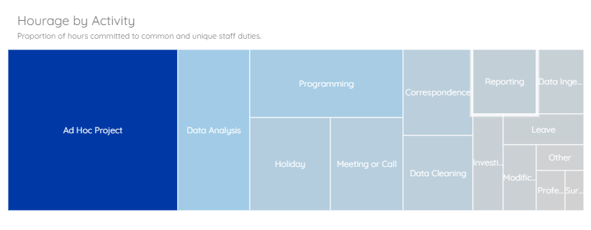
Example: Performance Dashboard
A.
Activity entered in Google Sheets (frontend)
Data are transformed as needed (backend)
Processed data informs Data Studio
B.
C.
Image Source: Crawford (2020)

Slide 9
Not bad.

Slide 10
Demo time.
Take ~ 20 seconds to take the quiz
shared in the chat.

Slide 11
Fun?
Metal Bands by Nation (2017). Metalstorm.net & World Bank. Kaggle.com (View) (Sheets).
Museums, Aquariums, and Zoos (2017). IMLS Administrative Records. Kaggle.com (View) (Sheets).
UFO Sightings (2019). Sigmond Axel, NUFORC. Kaggle.com (View) (Sheets).

Slide 12
Questions?

Slide 13
Picture This II Democratizing Data with Google Data Studio
Thank you for joining us!
Jamison Crawford, MPA
Contact: jcrawford52@gsu.edu
Download Presentation: github.com/jamisoncrawford/dataviz
Special Thanks:
Dori Neptune, MA

